Slide 1
TSS 2.4 Best practices to maintain integrity and security in software development
I can explain best practices to maintain integrity and security in software development (e.g. encryption, hashing, and digital signatures)

Slide 2
Encoding
is the process of applying a specific code, such as letters, symbols and numbers, to data for conversation into an equivalent cipher.
The difference between encoding and encryption is that encryption needs a key to encrypt/decrypt.

Slide 3
cryptography
Cryptography is the practice and study of secure communication in the presence of third parties. In the past cryptography referred mostly to encryption. Encryption is the process of converting plain text information to cipher text. Reverse is the decryption. Encryption is a mechanism to make the information confidential to anyone except the wanted recipients. Cipher is the pair of algorithm that creates encryption and decryption. Cipher operation is depends on algorithm and the key. Key is the secret that known by communicants. In addition, there are two types of encryption by keys used:

Slide 4
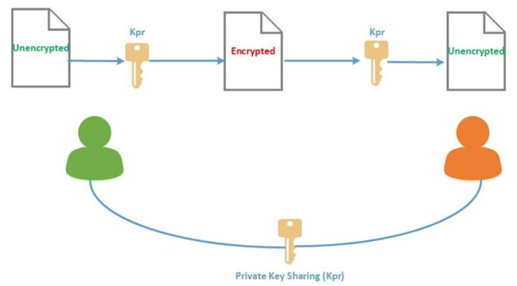
Symmetric Key Algorithms
Symmetric key algorithms (Private-key cryptography): same key used for encryption and decryption. (AES, DES etc.) (AWS KMS uses Symmetric Key Encryption to perform encryption and decryption of the digital data)

Slide 5
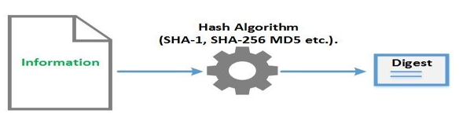
Cryptographic Hash Functions
Cryptographic hash functions are a third type of cryptographic algorithm. A message of any length taken as input, and output to a short, fixed length hash. (MD5, SHA etc.) It is a mathematical algorithm that maps data of arbitrary size to a bit string of a fixed size (a hash) and designed to be a one-way function, that is infeasible to invert. Integrity checking is the mechanism to verify if the information has not changed. To validate the integrity, a thumbprint (also called hash or digest) of the information created. Thumbprint created by an algorithm that create a shorter bit string from an information.

Slide 6
Digital Signature
Digital signature is a mathematical scheme for demonstrating the authenticity of digital messages or documents. A valid digital signature enables information integrity (using hash algorithm) to ensure message is not altered, message created by the sender (authentication) and sender cannot deny having sent the message (non-repudiation). The digital signature has to be authentic, unfalsifiable, non-reusable, unalterable and irrevocable. When all this property are gathered, the authenticity and the integrity of an information can verified.

Slide 7
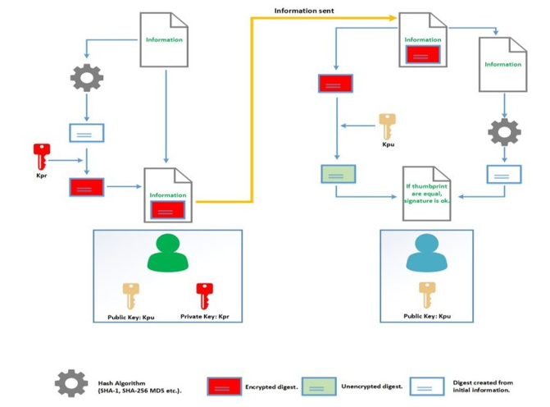

Slide 8
TSS 2.4 Best practices to maintain integrity and security in software development
I can explain best practices to maintain integrity and security in software development (e.g. encryption, hashing, and digital signatures)

